Slide 1
Atypical work and new forms of employment
Martin Risak
Department of Labour Law and Law of Social Security
Notes:
Crowdworking platforms (and often crowdworkers themselves) stress the advantages of this way of working: High autonomy as it regards the amount of work, the place to work and the way of working
– I do not want to get into the discussion now that this is often an illusion and that it massively shifts risks that have to be borne by the employer in a „regular“ employment relationship to the worker. Not to mention the alienation from the work process as well as from the co-workers.

Slide 2
Overview
Atypical employment
  Deviations from the standard employment contract
  Strategies to cope with protection defecits for workers
The next step: „new“ forms of employment
  What is so „new“ about them?
  One example: crowdwork

Slide 3
Standard („typical“) employment
Full-time open-ended employment contracts with some kind of security
Issues and counter-strategies
  Wages: collective bargaining and statutory minimum wages
  Termination: general protection and special protection for certain groups
  Times of non-performance (esp. illness, annual leave): continuation of payment, social benefits
  Extensive working hours: working time laws
  Unilateral decisions affecting employee-interests: information/consultation/co-determination

Slide 4
Atypical employment
Three main forms of atypical employment
  Part-time work
  Fixed-term employment
  Temporary agency work (triangular employment relationships)
Other forms of atypical employment
  Seasonal work, telework, family work, self-employment
  Not that prevalent in the past -> some come up again as „new“ forms of employment

Slide 5
Atypical employment: why?
The employer perspective
Added flexibility avoiding the risks (and costs) associated with standard employment (and the legal benefits for workers that come with it)
Reducing the risk of paying for unproductive time
Avoiding the difficulties (and/or costs) connected with dismissal protection
Shifting risks to employees, temporary-work agencies or contractors
Avoiding costly collective bargaining agreements

Slide 6
Atypical employment: why?
The employee perspective
Added flexibility to combine (paid) work with other activities (e.g. childcare, household-duties, education, self-employment)
Job creation
Job opportunities for persons excluded from standard employment
But: lack of entitlements and benefits associated with standard employment

Slide 7
Legal strategies on the EU-level
Part-time work (Directive 97/81/EC concerning the Framework Agreement on part-time work)
  Principle of non-discrimination, principle of pro-rata temporis
  Opportunities for part-time work (transfers from full-time to part-time and vice versa)
Fixed term contracts (Directive 1999/70/EC concerning the framework agreement on fixed-term work)
  Principle of non-discrimination
  Measures to prevent abuse from successive fixed-term employment contracts
  Information and employment/training opportunities

Slide 8
Legal strategies on the EU-Level
Temporary agency work (Directive 2008/104/EC)
  Principle of equal treatment
  Access to employment, collective facilities and vocational training
  Representation of temporary agency workers
Outsourcing (Directive 2001/23/EC – transfer of undertakings)
  Safeguarding of employees‘ rights (employment contracts, collective agreements, dismissal, representation)
  Information and consultation

Slide 9
And now: New forms of employment
Eurofound (2015)
Need for increased flexibility for both employers and workers
What is „new“?
  Transformation of the traditional one-to-one relationship between employer and employee: employee-sharing, job-sharing, interim management
  Unconventional work patterns: portfolio work, crowd employment, collaborative employment
  Unconventional places of work: information and communication technology (ICT)-based work
  Irregular provision of work: casual work (zero-hours contracts)

Slide 10
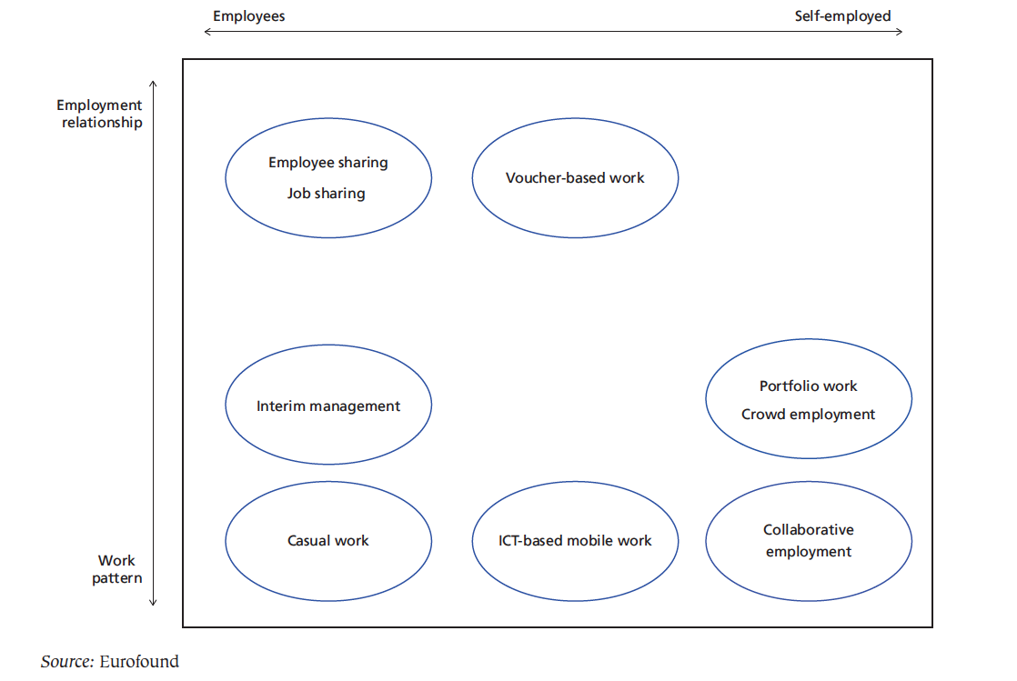
New forms of employment

Slide 11
„Remember outsourcing? Sending jobs to India and China is so 2003. The new pool of cheap labor: everyday people using their spare cycles to create content, solve problems, even do corporate R & D.“
„For the last decade or so, companies have been looking overseas, to India or China, for cheap labor. But now it doesn’t matter where the laborers are – they might be down the block, they might be in Indonesia – as long as they are connected to the network.“

Slide 12
„The labor isn’t always free, but it costs a lot less than paying traditional employees. It’s not outsourcing; it’s crowdsourcing.“
(Jeff Howe, The Rise of Crowdsourcing, WIRED magazine 10.2006)

Slide 13
Crowdsourcing: How does it work?
Plat-
form
Crowd-sourcer
Crowd-
worker
Internal – external crowdsourcing
Different types of „tasks“
Notes:
First I want to take a look at the relationship between the crowdsourcer and the platform.
The question is what are the obligations of the platform? Does it only provide the virtual infrastructure as well as the crowd? Does it act just as an agent for the outsourcer and the contract to actually complete a task and to pay for it is concluded between the crowdworker and the platform?
On the other hand the platform may also undertake to deliver the task itself and then sub-contract the fullfillment of the tasks to the crowdworker. In this case no direct relationship between the crowdsourcer and the crowdworker exists.

Slide 14
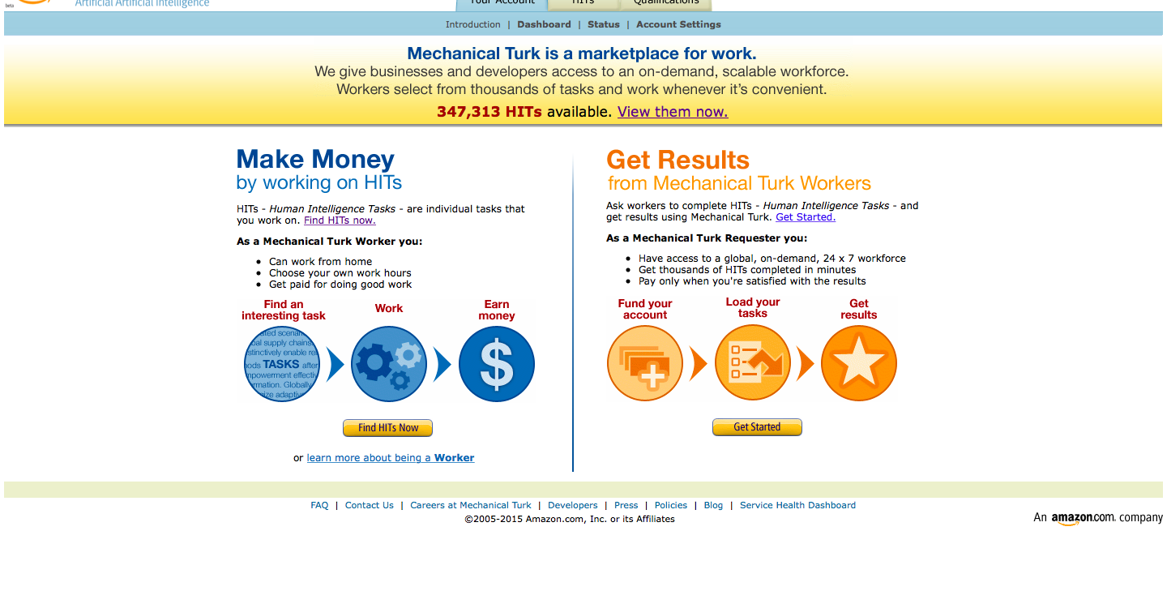
How does it work in practice? www.mturk.com
Notes:
n the late 1760s, a Hungarian nobleman named Wolfgang von Kempelen built the first machine capable of beating a human at chess. Called the Turk, von Kempelen’s automaton consisted of a small wooden cabinet, a chessboard, and the torso of a turbaned mannequin. Not very politically correct drawing on exotism ...

Slide 15
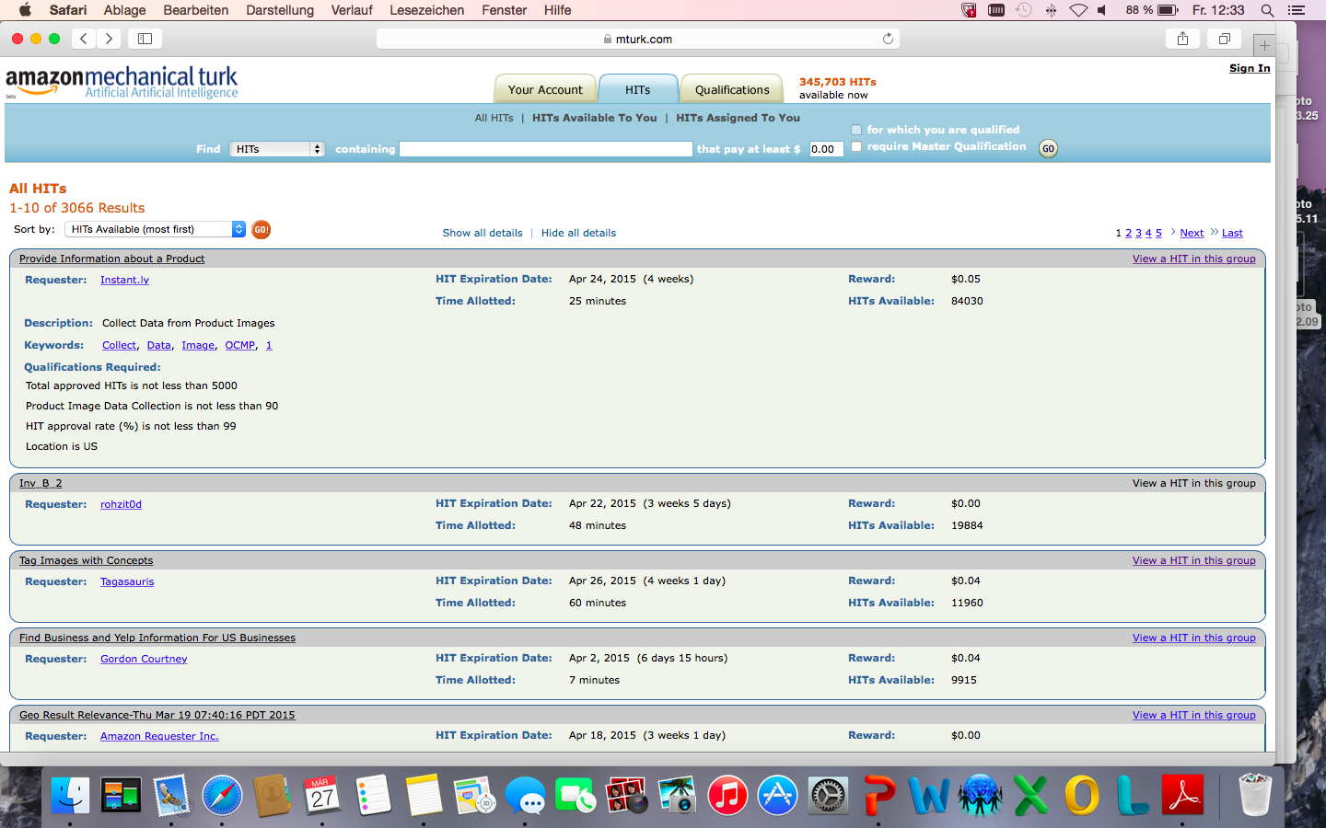

Slide 16
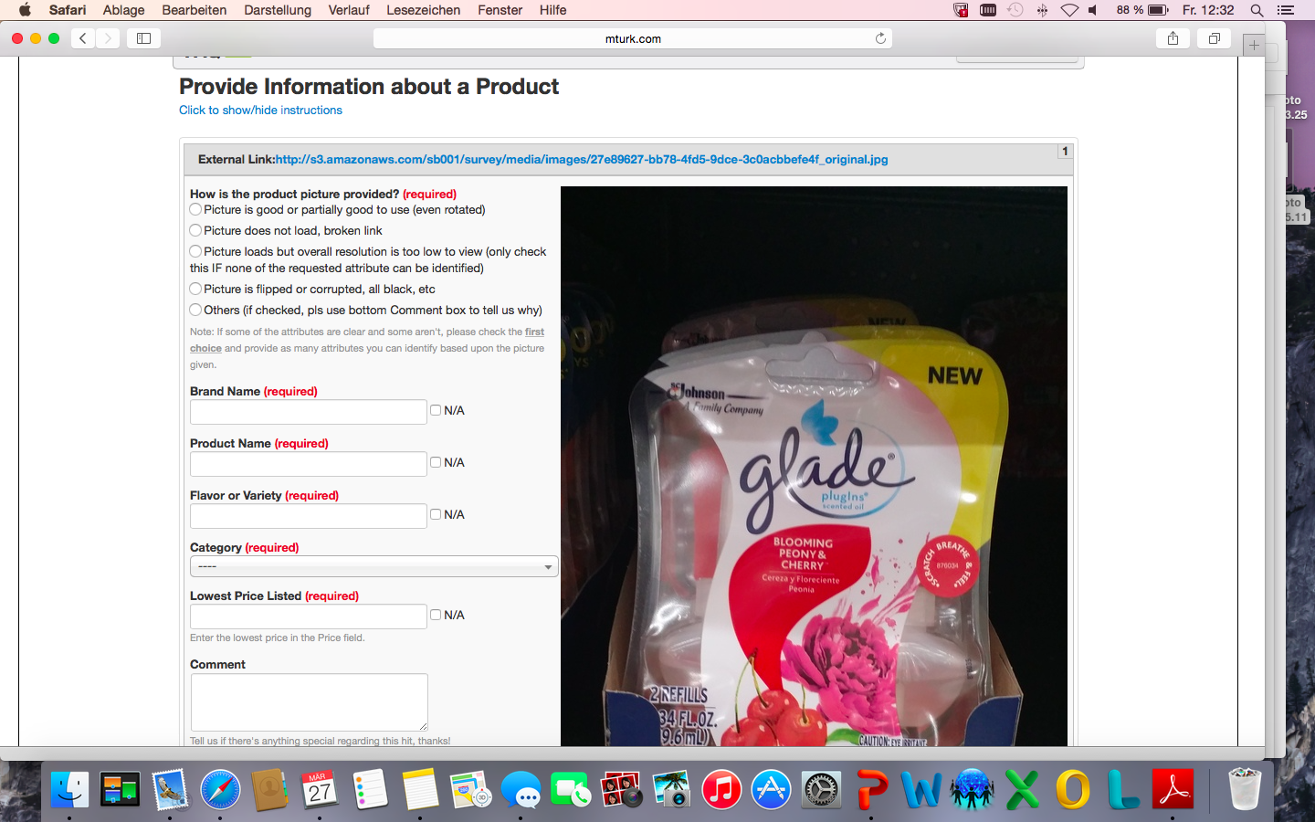

Slide 17
Major issues for crowdworkers in practice
Low wages
Job insecurity
Social and professional isolation
Unfair general terms & conditions (T&Cs)
  Right not to accept completed task without having to give a reason nor payment
  Reputation mechanisms
No direct contact with crowdsourcers (esp. feed-back for rejections)
Notes:
In the second half of our presentation I want to touch on th micro-issues crowdworkers raise themselfes without questioning the core this mode of working.
These issues are:
low wages
unfair gereral terms & conditions of the platform and
reputation mechanismus that hinder mobility and provide platforms with possiblities to discipline crowdworkers
as well as the lack of contact with the crowdsourcers
How can we tackle these issues? Here, with the limited time available and because we are both trained lawyers, I only want to outline some options that are available in the legal arena.

Slide 18
Two legal questions
(and one follow-up question)
Who are the contractual partners?
What kind of contract exists between them?
Do minimum wages apply?
Notes:
To do so, I want to rephrase the issues into two legal questions that may help - at least - to bring some clarity into the rather muddled picture about the legal situation of crowdworkers.
Who are the contractual partners?
As it was pointed out by Johannes we have three parties (the crowdsourcer, the platform and the crowd). And it is often not clear between whom what contract has been concluded. This, of course, can be a strategy to obstruct crowdworkers to enforce their legal rights, so clarity alone is a first step to a solution.
The second question is:
What kind of contract exists between those parties?
For answering this an overall assessment of the actual situation has to be undertaken. It’s result may differ from what the crowdsourcer and/or the platform have written in their contracts as they may have been used them to disguise the true economic content and therefore the correct classification of the contractual relationships.
And keep in mind that this classification is not only of academic interest but of practical importance as, for example, minimum wages usually apply only to employment relationships.

Slide 19
Contractual Partners
Plat-
form
Crowd-sourcer
Crowd-
worker
Platform is only a broker and acts as an agent for the crowdsourcer
Platform is sole contracting partner of the crowdsourcer
→ crowdworkers are subcontractors of the platform
Notes:
First I want to take a look at the relationship between the crowdsourcer and the platform.
The question is what are the obligations of the platform? Does it only provide the virtual infrastructure as well as the crowd? Does it act just as an agent for the outsourcer and the contract to actually complete a task and to pay for it is concluded between the crowdworker and the platform?
On the other hand the platform may also undertake to deliver the task itself and then sub-contract the fullfillment of the tasks to the crowdworker. In this case no direct relationship between the crowdsourcer and the crowdworker exists.

Slide 20
Contractual Partners
Plat-
form
Crowd-sourcer
Crowd-
worker
Is there a direct contractual relationship?
When is the contract concluded? Right to reject completed tasks (T&Cs)?
What kind of contract?
  Employment contract or
  contract for services?
Notes:
If the platform acts as a mere agent for the crowdsourcer there is no direct contractual relationship between the crowdworker and the platform. This has to be made clear at every step of the transaction in order to avoid any reasonable cause for the crowdworker to assume that the platform is acting on it‘s own behalf and therefore his/her contractual partner.
In all other constellations a contractual relationship between the crowdworker and the platform exists which raises a number of follow-up questions:
One of them concerns the time when the contract is concluded. The later this takes place the longer it is possible not to accept the completed task and not to pay remuneration.
The other is about the type of contract: Is it an employment contract or a contract for services?
I will come to this at the end of the presentation and will now move on to the last of the three possible contractual relationships:

Slide 21
Contractual Partners
Plat-
form
Crowd-sourcer
Crowd-
worker
Is there a direct contractual relationship?
What kind of contract?
Notes:
The relationship between the crowdsourcer and the crowdworker
The crucial element here is the role the platform takes in relation to the two other parties:
Is it a mere agent of the crowdsourcer and all acts vis-a-vis the crowdworker are to be considered acts of the crowdsourcer?
Or does the platform act on it‘s own behalf vis-à-vis the crowdworker?
In the first case there is no direct relationship between the platform and the crowd and in the latter there is only a contractual relationship between the crowd and the crowdsourcer.
This leads to the last question I want to cover here → Is there an employment relationship?

Slide 22
Employment Relationship?
Contra employment relationship
  Workers choose when, where and what to work
  Very short duration of the contract
  Perception/agreement of the parties that no employment contract is concluded
Pro employment relationship
  Every task a fixed term contract
  Tight virtual controls
  Performance management via reputation system
Notes:
As mentioned before, this is important because protective labour laws, especially minimum wages or working time restrictions only apply to employment contracts. In addition also the provisions that deal with the right to organize, to collectively bargain and to industrial action only cover workers and not independent contractors.
For an employment relationship it is essential for the work to be rendered in what we call “personal dependency”: When working, the party performing the work must be integrated into the operational body of the employer and be subject to his/her instructions.
The main argument against an employment relationship is in the crowdworking-arrangement the workers decide when, from where (usually from at home) and what to work.
This positive view is too positive though as it does not take into account that crowdworking takes place not only in the home of the crowdworker but at the same time also online in a kind of “virtual workshop”. The crowd has to use the interface provided by the crowdsourcing platform, that often involves monitoring mechanisms like regular screenshots or the automated analysis of the workflow or even typing patterns. The opportunities for disciplining the crowdworker through ratings on the platform should also be taken into account. The same goes for the determination of work-related behaviour, for example through the specification of allotted time. Taken together, the determination of the work related behaviour by the contractual partner is often so pronounced that it equals “classical” personal dependency necessary for an employment relationship.
I now come to an end. I hope this presentation has served its purpose to sensitize you to crowdworking which is on the one hand fascinating and on the other also frightening. It has a high potential of exploiting workers and to errode labour standards. We are very interested about your opinion on this phenomenon and about your ideas on how to cope with issues involved.

Slide 23
Thank you very much for your interest and attention!
Assoc.-Prof. Martin Risak, PhD
Department of Labour Law and Law of Social Security
University of Vienna
Schenkenstrasse 8 – 10, 1010 Wien, AUSTRIA
martin.risak@univie.ac.at
http://www.univie.ac.at/arbeitsrecht

