Slide 1
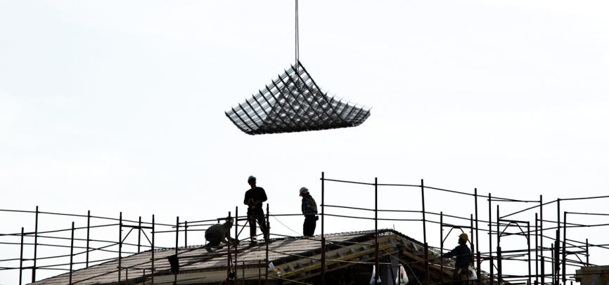
Risk assessment:
online and interactive with OiRA
The importance of prevention
5 October 2016 - Zagreb
Notes:
1

Slide 2
Challenge: reaching MSEs (and making them act)
When it comes to MSEs, one of the main challenges is simply to reach them
The “promotional” side of OiRA is critical for the project
The OiRA community is fully aware of this and is already addressing this issue by:
improving knowledge on this specific issue;
increasing the range of means/channels traditionally used to reach MSEs (by using/setting up new ones);
integrating OiRA in a more global strategy (and not as a stand-alone product).
OiRA promotional strategy 2014-2020 published by EU-OSHA, available at www.oiraproject.eu

Slide 3
OiRA Promotion / Dissemination - Key issue for the project
Even if we develop good quality tools they are useless if we do not manage to reach the end-users
Reaching them is the first challenge and make them use OiRA the second one
Low take up of OiRA by end-users is considered as a High Risk for the OiRA Project (risk assessment of the OiRA Project)
With the OIRA statistics we can monitor the use of the tools, so we know if the tools are used or not

Slide 4
Monitor your impact
Mailing
(leaflet)

Slide 5
OiRA – as a project – encourages …
Setting up a promotional strategy for each single tool / sector
Conduct insight research of the target audience before carrying out any promotion actions.
Use the relevant partners/channels to reach the target audience.
Adapt the “messages” to each specific sector.
Planning a campaign and not just individual and isolated actions
Adding new communication channels (Twitter, Facebook, LinkedIn, etc.) to the traditional ones
Using influencers, large multipliers
Sending the “correct” messages to micro and small enterprises (adapting them to each specific sector)
Disseminating the tools through personal contact

Slide 6
OiRA promotion initiatives encouraged by EU-OSHA
Encourage OiRA partners to develop OiRA promotion strategies at National / tool level
Develop new potential promotional supports / channels
Social media (LinkedIn, Twiter, Facebook, …)
Foster the exchange of OiRA promotional material among OiRA partners
Develop a new OiRA website (2016) intended to OiRA partners
Resources / OiRA promotion material section with products produced by EU-OSHA or National OiRA partners

Slide 7
OiRA promotion 2016
OiRA website – Presentation
OiRA infographics
OiRA video
OiRA Social Media guide
OiRA products – factsheets: OiRA general, OiRA FAQ, …
OiRA community meeting

Slide 8
The tools & their promotion
The main responsibility to promote the tools lies with the OiRA partners
EU-OSHA´s main roles:
To promote the OiRA programme (in general) through the OiRA website, presentations, …..
To facilitate the echange of experience, good practice, promotional resources (factsheets, videos, …)
To support / help / guide the OiRA partners in the task of promoting / disseminating the tools by:
“Inviting” them to develop an OiRA promotional strategy
“Inviting” them to mobilise the required resources to promote their tools
“Developing” half-products to be adapted at national level
…

Slide 9
Information, documentation and supporting materials:
OiRA website (www.oiraproject.eu)

